Slide 1
Search Engine
Turning the search mode on…
Prepared by:
PRUTHIL HIRPARA:18CE031

Slide 2
Introduction
This is a simple search engine that gives you the details about Charusat University.
It gives you details such as admission process, hostels, courses offered and different activities conducted by the university.

Slide 3
HEADER FILES:
#include<iostream>
#include<fstream>
#include<windows.h>
#include<stdio.h>
#include<conio.h>
#include<mmsystem.h>
#include<stdlib.h>
#include<cstring>

Slide 4
FUNCTIONS:
*SetConsoleCursorPosition(GetStdHandle(STD_OUTPUT_HANDLE),NAME OF STRUCTURE):
→Basically this function is used to set the curser position on consol using x and y coordinates.
*Fflush(stdin):
→this function is used to flush the stream.it can flush all the buffer from stream.

Slide 5
FUNCTIONS:
*System(“cls”):
→Basically it is used to clear a consol.
*sleep(int):
→this function is used to delay the output on consol by providing according values.
*Beep(int):
→this function is used to provide sound effect on consol according to provided arguments.

Slide 6
Motivation
We got this motivation as we wanted to explore how a search engine can be managed without database management.
We explored through different ways of creating search engine and then we decided to make it using file management.

Slide 7
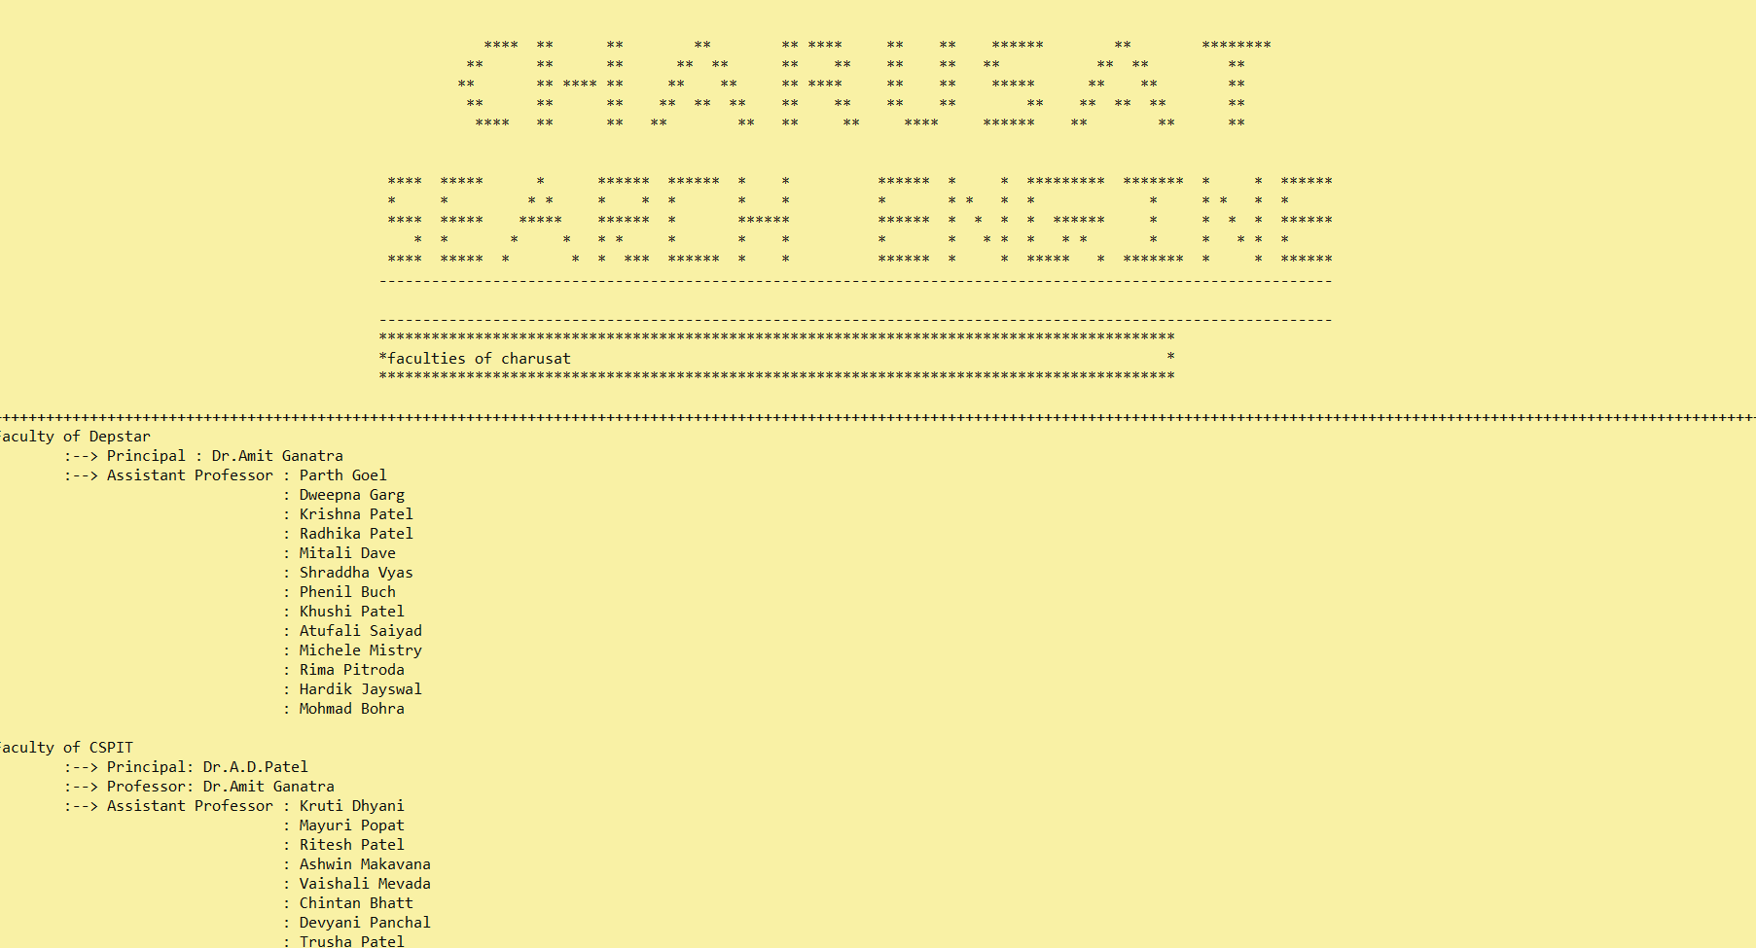
SCREENSHOT:

Slide 8
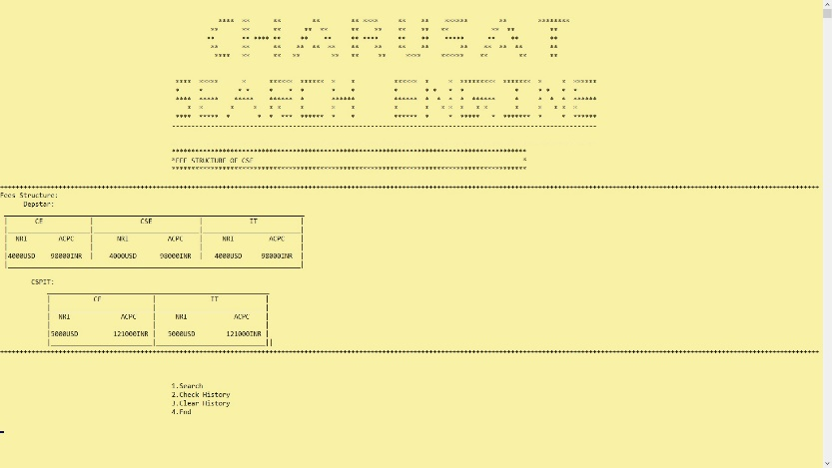

Slide 9
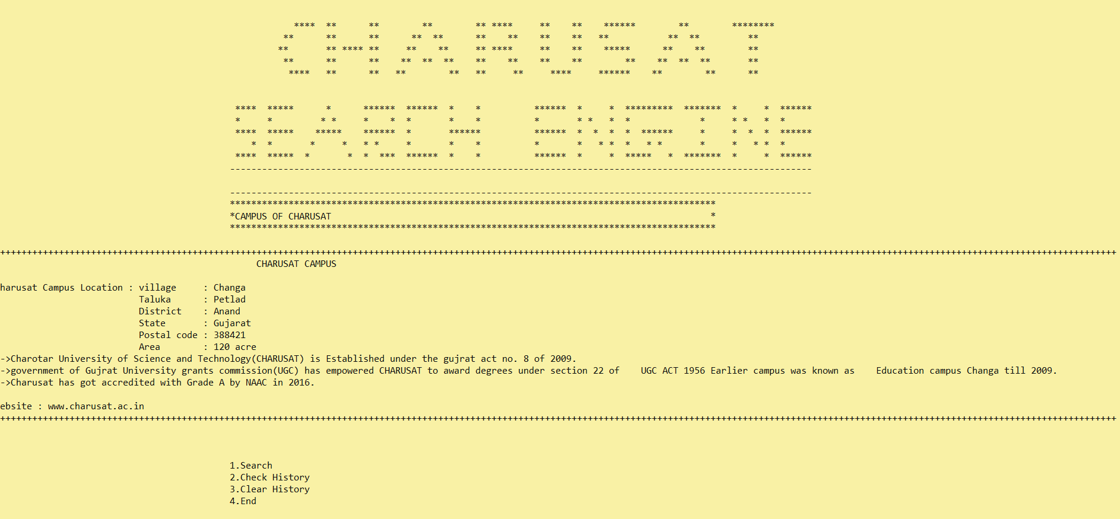

Slide 10
Applications
Researching information of University
Admission regarding queries
Precise information of the source

Slide 11
Challenges
Stemming algorithm
Colorful backgrounds and Graphics
Screen resolution (Formatting gets unsettled)
Linking of HTML with C++

Slide 12
Conclusion
As we have finished this project, we have got a better understanding about the inner workings of a search engine using file.
We have known more about use of graphics in C++.
Debugging and file management knowledge has increased along with concepts such as inheritance, constructor and destructor.

Slide 13
Thank You

